Slide 1
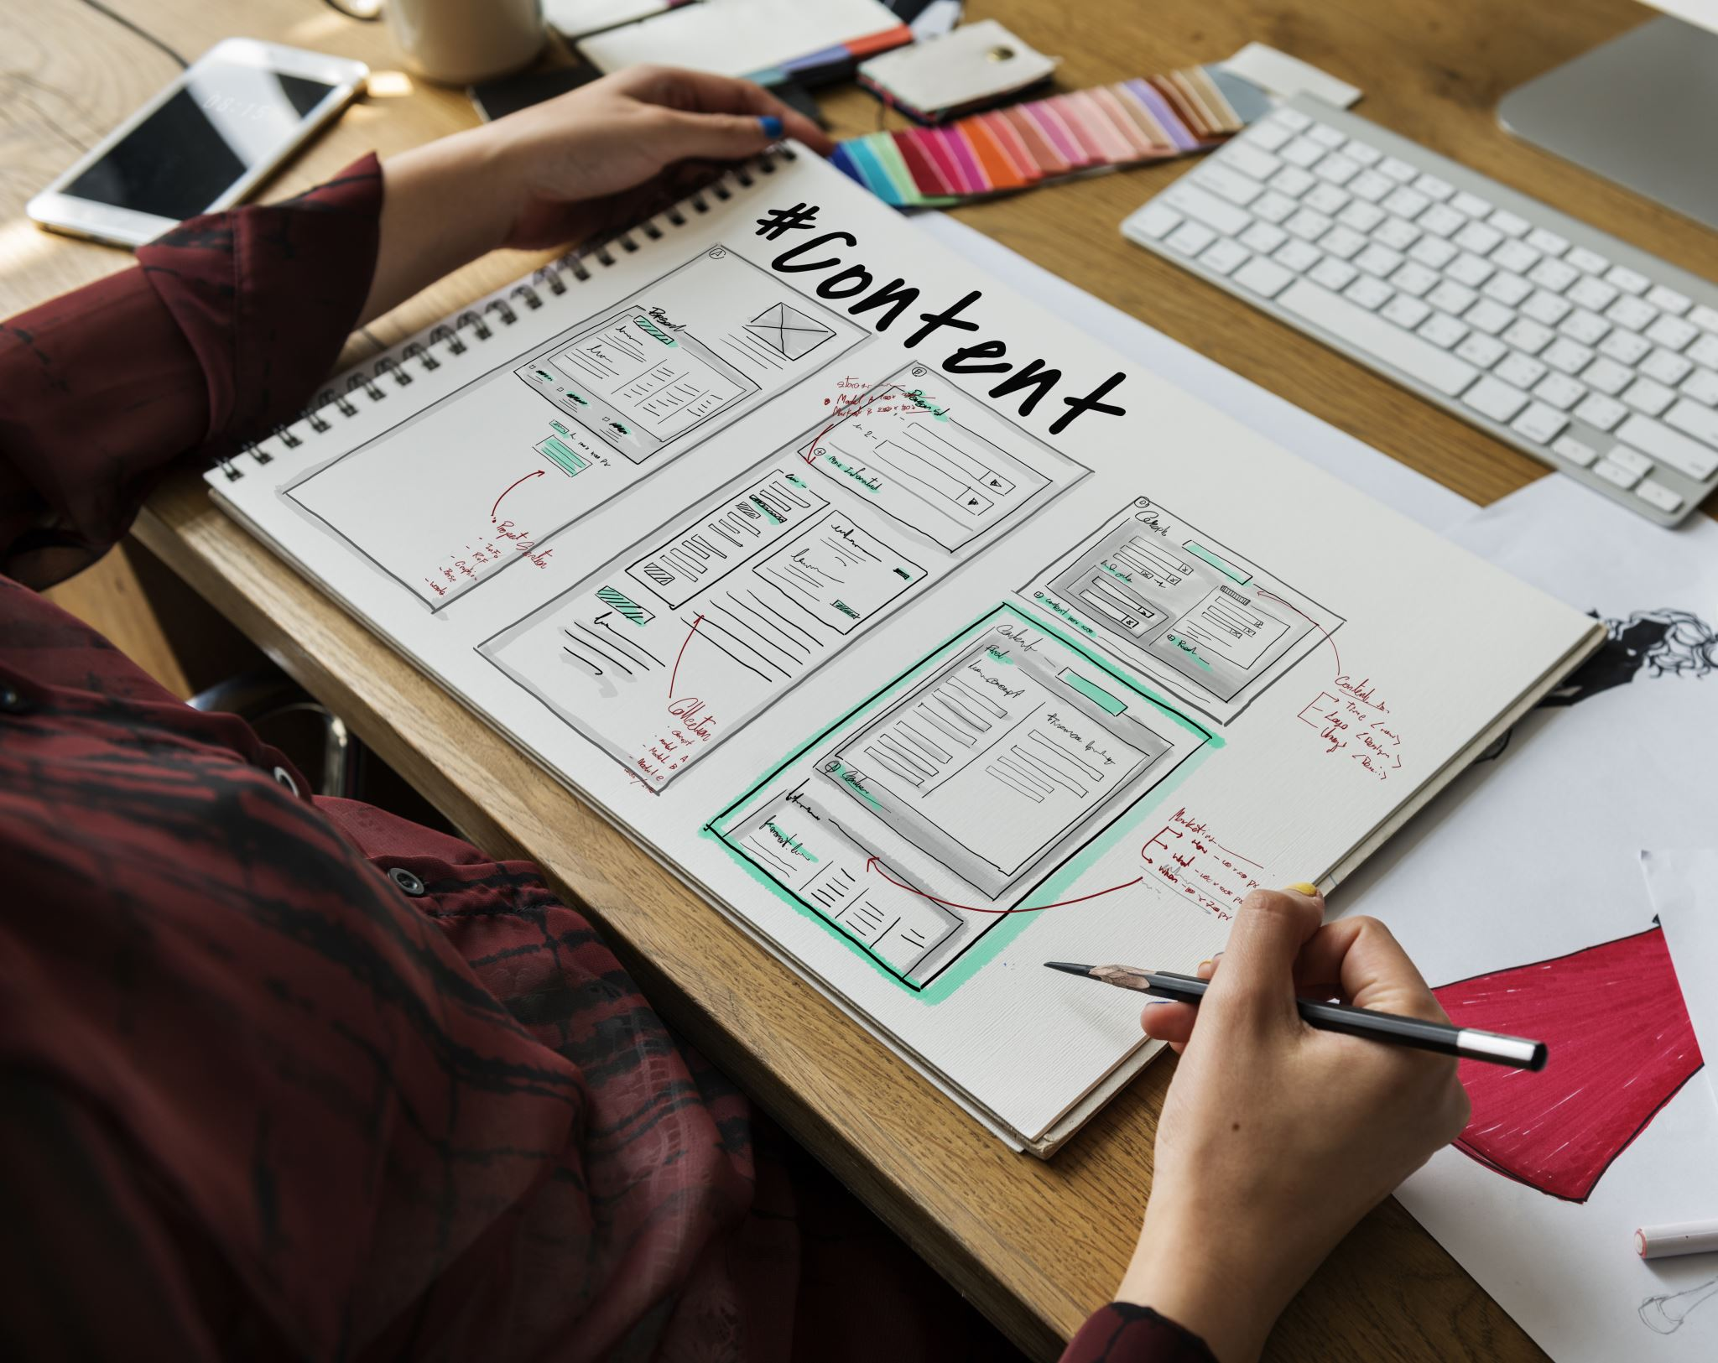
Web Based Library Management System
Innovate Coders
Faculty of Information Technology
University Of Moratuwa
2022

Slide 2
Problem in brief
Lack of Centralized System for Book Management: The library currently does not have an integrated software solution to efficiently manage books, making tracking and organizing the collection difficult.
Librarian Operations: Librarians struggle with unorganized tasks and activities, such as managing book inventories, tracking borrowing history, and handling member queries.
Limited Access to Book Information: Members have limited access to real-time information on book availability and details, hindering their ability to make informed borrowing decisions.
Inadequate Fine Management: The current system does not efficiently manage fines and overdue books, leading to inconsistencies and difficulties in enforcement.
Poor Communication: There is a lack of effective communication channels between librarians and members, resulting in delays and misunderstandings.

Slide 3
AIM
To develop a comprehensive Library Management System (LMS) specifically designed for schools to streamline library operations and enhance resource management.

Slide 4
OBJECTIVES
Implement secure user registration and management for students and librarians.
Provide real-time updates on book availability and inventory status.
Facilitate efficient borrowing and returning processes for library resources.
Automate fine calculations and management for overdue books.
Enable students to submit and manage articles in a dedicated section.
Allow librarians to add, update, and manage book details and inventory.
Enhance communication between students and librarians regarding resource requests and updates.
Provide a platform for students to submit articles, including functionality for article review and approval by librarians.
Allow students to view and manage their submitted articles, including tracking submission status.
Enable librarians to categorize, archive, and manage submitted articles efficiently.
Support flexible development using the Agile Scrum methodology to adapt to changing user requirements.

Slide 5
Proposed Solution
Below are the main and sub-modules we created from the proposed solution for the Library Management System:
Authentication & Authorization Module
User verification against student and teacher databases
Role-based access control to prevent unauthorized actions
Librarian (Admin) Dashboard
Comprehensive interface for librarians to manage books and users
Administrative task management features
Intuitive design for efficient library operations
Library Home
Main interface displaying book details and availability
Chat system for communication between librarians and members
Enhanced search functionality for book availability
Article Section
Adding, editing, and managing articles
Upload and maintenance functionalities for supervisors and content creators
Comments and ratings to foster user interaction and feedback
Member Management
Managing member accounts and profiles
Fine management for overdue books
Smooth user interactions and timely notification

Slide 6
Use Case Diagram

Slide 7
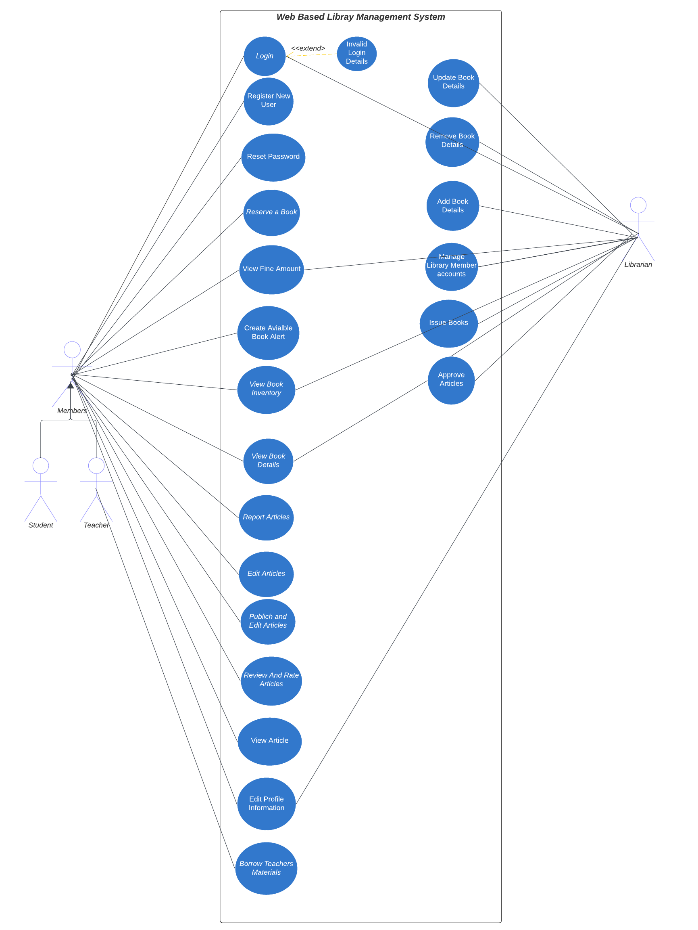

Slide 8
EER DIAGRAM

Slide 9
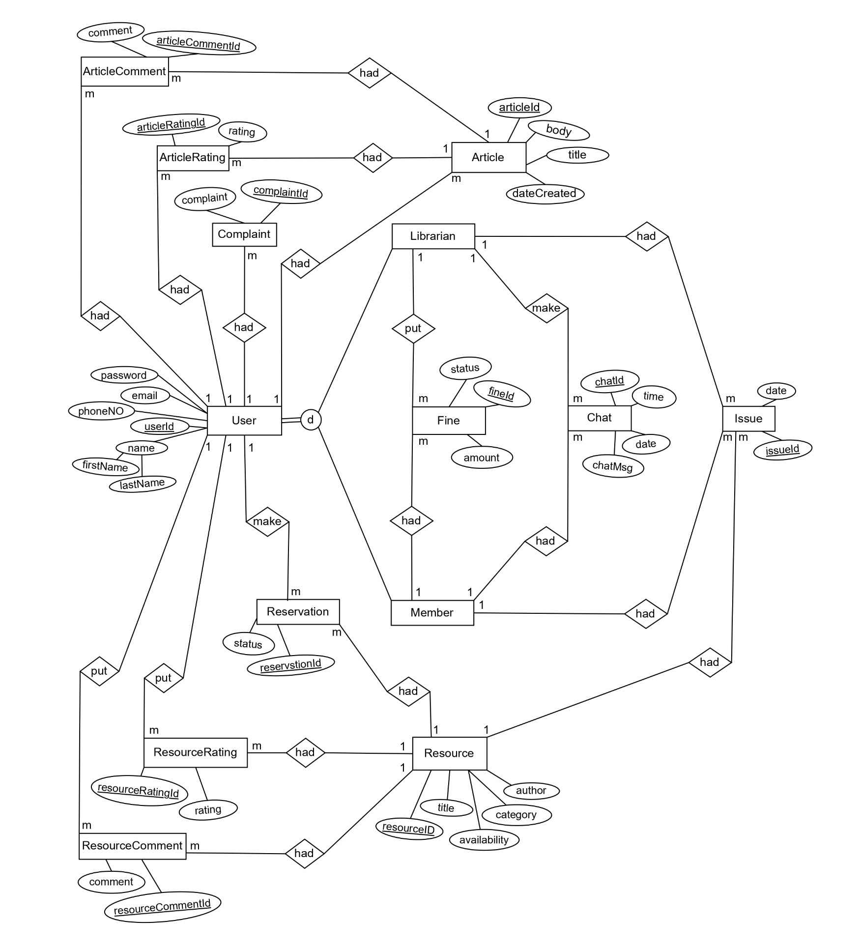

Slide 10




Technologies Used
Figma
React js
Spring boot
MySQL

Slide 11
Achievements
Efficient Library Management: The system streamlines the management of library resources, reducing the errors associated with manual record-keeping and decentralized solutions.
Secure Authentication & Authorization: By integrating Google authentication and role-based access control, the system ensures secure and controlled access to library resources.
Enhanced User Experience: The intuitive interfaces for the librarian dashboard and library home make it easy for users to manage and access library resources efficiently.
Real-Time Availability: The system provides real-time updates on book availability, helping users quickly find and borrow the books they need.
Interactive Article Section: The article section allows for the addition, editing, and management of articles, fostering a rich repository of content for users.
Effective Fine Management: The system simplifies fine management, ensuring timely notifications and payments, reducing overdue instances.

Slide 12

Individual Contribution

Slide 13
Paranietharan P. 214145R
Article Section Management
Developed the article section to allow for adding, editing, and managing articles.
Implemented functionalities for supervisors and content creators to upload and maintain articles.
Enabled comments and ratings for articles, fostering user interaction and feedback.

Slide 14
Shobikan V. 214197C
Authentication and Authorization
Developed a secure login system with Google integration.
Implemented user verification against student and teacher databases.
Ensured robust permission-based access control to prevent unauthorized actions.

Slide 15
Lathisana T. 214116F
Librarian (Admin) Dashboard
Created a comprehensive dashboard for librarians to manage the library system.
Integrated features for managing books, users, and other administrative tasks.
Ensured an intuitive interface for efficient library management.

Slide 16
Mihunan V. 21413H
Library Home
Developed the main interface displaying book details and availability.
Implemented a chat system for direct communication between librarians and members.
Enhanced user experience by making book searches and availability checks seamless.

Slide 17
Yasothan R. 214240E
Member Side Functions
Developed functionalities for managing member accounts and profiles.
Implemented fine management for overdue books.
Enhanced the user experience by ensuring smooth interactions and timely notifications.

Slide 18

Thank You Q & A

